Slide 1
Big Data Analytics 2023 Module 4 –Mining Big Data Streams

Slide 2
Overview
The Stream Data Model:
A Data-Stream-Management System
Examples of Stream Sources
Stream Queries
Issues in Stream Processing.
Sampling Data in a Stream
Sampling Techniques.
Filtering Streams
The Bloom Filter
Counting Distinct Elements in a Stream
The Count-Distinct Problem
The Flajolet-Martin Algorithm
Combining Estimates
Space Requirements
Counting Ones in a Window:
The Cost of Exact Counts
The Datar-Gionis-Indyk-Motwani Algorithm
Query Answering in the DGIM Algorithm

Slide 3
Motivating Examples

Slide 5
Example DEBS Challenge – Soccer Analytics

Slide 6

Achieve real time customer intelligence
For many enterprises, high performance clickstream processing is a vital business function.
From websites to mobile devices, we need to capture and immediately process customer interactions.
Results in real-time business intelligence, reporting, personalization, and dynamic pricing.

Slide 7
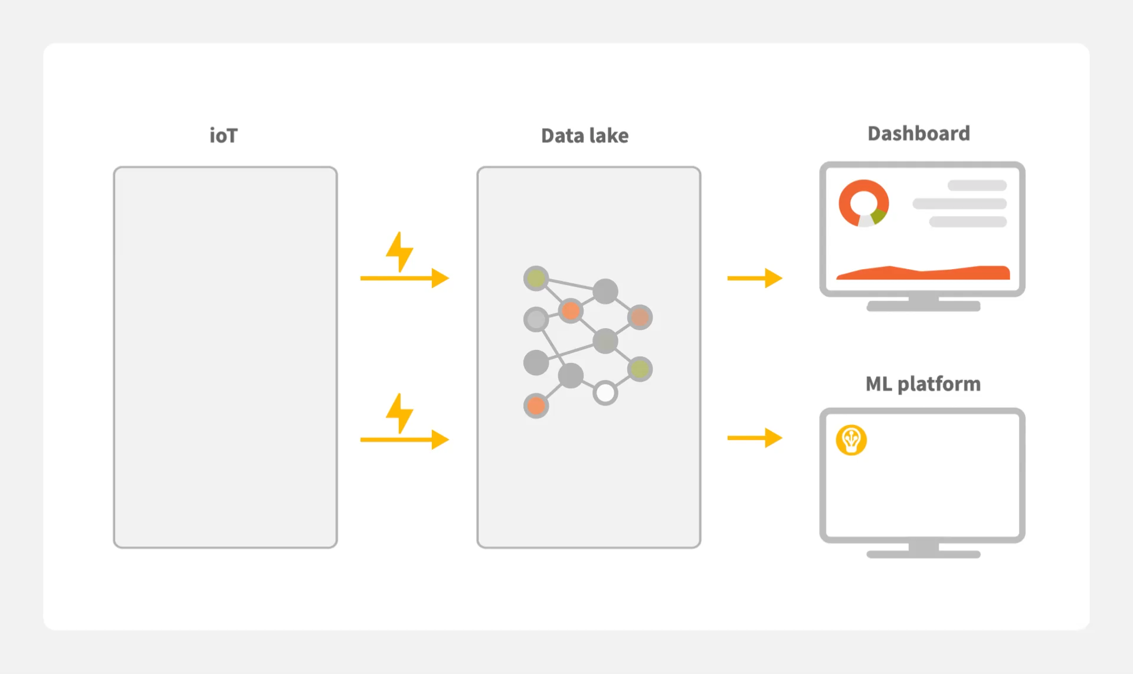
Process events from IoT devices
Smart factories, connected cars, smart cities, and other IoT devices generate a lot of data continuously.
Stream processing solution captures IoT data streams and processes them in a centralized way

Slide 8

Immediately detect & prevent suspicious activity
In any type of financial transaction fraud or ad fraud, streaming is necessary to detect and automatically react to suspicious activity in real-time.
We can combine state of the art machine learning anomaly detection algorithms with high performance stream processing engines to prevent fraud.

Slide 9

Data Streams (Streaming Data)
Streaming data refers to data that is continuously generated, usually in high volumes and at high velocity.
A streaming data source would typically consist of a stream of logs that record events as they happen
user clicking on a link in a web page
sensor reporting the current temperature.
Common examples of streaming data include:
IoT sensors
Server and security logs
Real-time advertising
Click-stream data from apps and websites
A data stream is a constant flow of data, which updates with high frequency and loses its relevance in a short period of time.

Slide 10
Streams – A New Model
Traditional DBMS: data stored in finite, persistent data sets
Data Streams: distributed, continuous, unbounded, rapid, time varying, noisy, . . .
Data-Stream Management: variety of modern applications.
Network monitoring and traffic engineering
Sensor networks
Telecom call-detail records
Network security
Financial applications
Manufacturing processes
Web logs and clickstreams
Other massive data sets…

Slide 11
Typical Applications
Heavy machinery/transportation/fleet operations: sourcing data streams from sensors and IoT devices;
Healthcare: real-time monitoring of health-conditions, clinical risk-assessment, client-state analysis, and alerts;
Finance: transaction processing, market/currency state monitoring;
Retail/customer service: customer behavior analysis and operations improvement;
Manufacturing/supply chain: real-time monitoring, predictive maintenance, disruption/risk assessment;
Home security: IoT data stream analysis, smart protection, and alert systems improvement;
Security : CCTV footage

Slide 13
Uber: Chaperone Tool (KafKa)
An international ride-hailing and food-delivery service.
two real-time instances:
Tracking location of drivers and clients requires constant data flow and updates of geolocation, pushing this data to both types of application users. This means that Uber has to deal with petabytes of messages to keep track of data flow.
Constant financial flow coming from Uber users that make payments directly through the application requires monitoring. Financial operations mean there is a high risk of fraud. So, in addition to the amount of controlling streamed data, Uber also has to be on the alert with fraud detection.

Slide 14
Human resources
By applying streaming analytics to data streams, such as email, time reporting apps, injury reports, and other resources, managers can gain deeper insights into behavioral patterns that may suggest an employee is burning out due to excessive hours or actively interviewing at other companies.
The insights can help HR professionals and line-of-business managers proactively balance workloads, offer more competitive compensation, or provide training and development to retain valued team members.

Slide 15
DBMS vs. DSMS #1
SQL Query
Result
Continuous Query (CQ)
Result
Query Processing
Main Memory
Query Processing
Disk
Main Memory
Data Stream(s)
Data Stream(s)

Slide 16
DBMS vs. DSMS #2
DSMS:
support on-line analysis of rapidly changing data streams
data stream: real-time, continuous, ordered (implicitly by arrival time or explicitly by timestamp) sequence of items, too large to store entirely, not ending
continuous queries
Traditional DBMS:
stored sets of relatively static records with no pre-defined notion of time
good for applications that require persistent data storage and complex querying

Slide 17
DBMS vs. DSMS #3
DBMS
Persistent relations (relatively static, stored)
One-time queries
Random access
“Unbounded” disk store
Only current state matters
No real-time services
Relatively low update rate
Data at any granularity
Assume precise data
Access plan determined by query processor, physical DB design
DSMS
Transient streams (on-line analysis)
Continuous queries
Sequential access
Bounded main memory
Historical data is important
Real-time requirements
multi-GB arrival rate
Data at fine granularity
Data stale/imprecise
Unpredictable/variable data arrival and characteristics
Adapted from [Motawani: PODS tutorial]

Slide 18
The Stream Model - 1
The data model and query semantics must allow order-based and time-based operations
The inability to store a complete stream indicates that some approximate summary structures must be used. As a result, queries over the summaries may not return exact answers.
Streaming query plans may not use any blocking operators that require the entire input before any results are produced.

Slide 19
The Stream Model - 2
Storage and performance constraints make backtracking over a data stream infeasible.
On-line stream algorithms are restricted to making only one pass over the data.
Applications that monitor streams in real-time must react quickly to unusual data values.
Parallel and shared execution of many continuous queries must be possible.

Slide 20
Generic DSMS Architecture
Input
Monitor
Working
Storage
Summary
Storage
Static
Storage
Output
Buffer
Query Processor
Query
Reposi-
tory
Streaming
Inputs
Streaming
Outputs
Updates to
Static Data
User
Queries

Slide 21
General Stream Processing Model
Ad-Hoc
Queries
Processor
. . . 1, 5, 2, 7, 0, 9, 3
. . . a, r, v, t, y, h, b
. . . 0, 0, 1, 0, 1, 1, 0
time
Streams Entering.
Each is stream is composed of elements/tuples
Standing
Queries
Output
Limited
Working
Storage
Archival
Storage

Slide 22
Data Streams Mining
Definition
Continuous, unbounded, rapid, time-varying streams of data elements
Application Characteristics
Massive volumes of data (can be several terabytes)
Records arrive at a rapid rate
Goal
Mine patterns, process queries and compute statistics on data streams in real-time

Slide 23
Streaming Analytics
Big data streaming is a process in which large streams of real-time data are processed with the sole aim of extracting insights and useful trends out of it.
A continuous stream of unstructured data is sent for analysis into memory before storing it onto disk.
This happens across a cluster of servers.
Speed matters the most in big data streaming. The value of data, if not processed quickly, decreases with time.
Real-time streaming data analysis is a single-pass analysis. Analysts cannot choose to reanalyze the data once it is streamed.

Slide 24
Data stream Mining – Challenges
Mining big data streams - In addition to Volume, Velocity, Variety also Volatility.
Volatility - dynamic environment with ever-changing patterns.
Concept drift is a phenomenon that occurs when the distributions of features x and target variables y change in time.
As data streams have no beginning or end, they can’t be broken into batches. So there is no time when the data can be uploaded into storage and processed. Instead, data streams are processed on the fly.

Slide 25
Challenges
Single pass: each record is examined at most once (random access not possible)
Bounded storage: limited memory for storing synopsis
Real-time: per record processing time (to maintain synopsis) must be low
As new data arrives older data discarded to make room for subsequent examples.
The algorithm processing the stream has no control over the order of the examples seen, and must update its model incrementally as each example is inspected.
An additional desirable property, the so-called anytime property, requires that the model is ready to be applied at any point between training examples
Generally, algorithms compute approximate answers

Slide 26
Applications (1)
Mining query streams
Google wants to know what queries are more frequent today than yesterday
Mining click streams
Yahoo wants to know which of its pages are getting an unusual number of hits in the past hour
Mining social network news feeds
E.g., look for trending topics on Twitter, Facebook

Slide 27
Applications (2)
Sensor Networks
Many sensors feeding into a central controller
Telephone call records
Data feeds into customer bills as well as settlements between telephone companies
IP packets monitored at a switch
Gather information for optimal routing
Detect denial-of-service attacks

Slide 28
Interesting Use Cases
Customer experience and interaction
When a customer visits a retail website, their website movements get tracked, as well as their purchasing preferences and choices.
Recognizing and responding to consumer buying patterns in real time can be integrated into marketing so a customer looking at slacks could suddenly see an offer for matching shirts.

Slide 29
Interesting Use Cases
Environmental sensing
Ambient temperatures in data centers, conference rooms, offices, warehouses, refrigeration units, hospital operating rooms, etc., are all part of providing viable work space.
If a sensor in a room suddenly detects temperatures or humidities that are falling outside of range, an auto-alert can be sent, and a maintenance person can be dispatched.
The technology can save lives, prevent food spoilage, and keep data centers running.

Slide 30
Interesting Use Cases
Systems geo-tracking and security
Who's tapping into your systems and networks, when and from where are all important elements of security and governance.
So is the ability to track foot traffic through plants and offices.
In 2020, IBM reports that the cost of a single data breach was $3.8 million, so the savings in cost and company reputation are significant.

Slide 31
Interesting Use Cases
Industrial IoT
A machine failure on an assembly line can cost $1 million per day.
That failure can be prevented by an industrial sensor that can detect a machine failing in real time before it happens.
This kind of preemptive maintenance keeps assembly lines running and saves millions of dollars.
Logistics
Logistics companies track trucks and cars on the road with IoT sensors.
They are able to see which vehicles will arrive on time, or ahead of, or behind schedule.
They can observe vehicle proximity and reroute a vehicle if another vehicle in the area suffers a breakdown.
All of this is facilitated with IoT devices and sensors attached to vehicles that are monitored in real time.
The savings can mount up. For refrigerated trucks alone, the late fee for one load of cargo can be $500.

Slide 32
Interesting Use Cases
Patient monitoring
Healthcare clinics and hospitals can now automatically receive vitals readings from patients who are at home.
Alerts are issued if a patient's data indicates a dangerous condition.
Fraud detection
In a flash, a bank card processor can detect a fraudulent credit card transaction as soon as the perpetrator passes the card through a card reader.
The transaction gets denied, and no money is lost.

Slide 33
Overview Data Stream Processing

Slide 34
Data Stream Queries -- Types
Answer availability
One-time
Multiple-time
Continuous (“standing”), stored or streamed
Join queries
Registration time
Predefined
Ad hoc

Slide 35
Stream Queries Issues - 1
Unbounded Memory Requirements
Approximate Query Answering
data reduction and synopsis construction
Sketches, random sampling, histogram & wavelets
Sliding Windows : Storing only recent elements
SELECT AVG(S.minutes)
FROM Calls S [PARTITION BY S.customer id
ROWS 10 PRECEDING
WHERE S.type = ’Long Distance’]

Slide 36
Stream Queries Issues - 2
Join Queries
return the average length of the last 1000 telephone calls placed by “Gold” customers:
SELECT AVG(V.minutes)
FROM (SELECT S.minutes
FROM Calls S, Customers T
WHERE S.customer id = T.customer id
AND T.tier = ’Gold’)
V [ROWS 1000 PRECEDING]
Notice that in this example, the stream of calls must be joined to the Customers relation before applying the sliding window.

Slide 37
Stream Queries Issues - 3
Batch Processing, Sampling, and Synopses
In batch processing, rather than producing a continually up-to-date answer, the data elements are buffered as they arrive, and the answer to the query is computed periodically.
In sampling some data points must be skipped altogether, so that the query is evaluated over a sample of the data stream rather than over the entire data stream.
can often design an approximate data structure that maintains a small synopsis or sketch of the data rather than an exact representation, and therefore is able to keep computation per data element to a minimum.

Slide 38
Stream Queries Issues - 4
Blocking Query Operator
is a query operator that is unable to produce an answer until it has seen its entire input. Sorting is an example of a blocking operator, as are aggregation operators such as SUM, COUNT, MIN, MAX, and AVG.
Dealing with them effectively is one of the challenges of data stream computation.

Slide 39
Stream Query processing Issues

Slide 40
Data Streams Operations
Sampling data from a stream
Filtering a data stream
Select elements with property x from the stream
Counting distinct elements
Number of distinct elements in the last k elements of the stream
Counting no of 1s in a window

Slide 41
Sampling
Sampling is a common practice for selecting a subset of data to be analyzed.
We select instances at periodic intervals.
Sampling is used to compute statistics (expected values) of the stream.
The main problem is to obtain a representative sample, a subset of data that has approximately the same properties of the original data.

Slide 42
Sampling from a Data Stream
Since we can not store the entire stream, one obvious approach is to store a sample
Two different problems:
(1) Sample a fixed proportion of elements in the stream (say 1 in 10)
(2) Maintain a random sample of fixed size over a potentially infinite stream
At any “time” k we would like a random sample of s elements
What is the property of the sample we want to maintain? For all time steps k, each of k elements seen so far has equal prob. of being sampled

Slide 43
Maintaining a fixed-size sample
Suppose we need to maintain a random sample S of size exactly s tuples
E.g., main memory size constraint
Why? Don’t know length of stream in advance
Suppose at time n we have seen n items
Each item is in the sample S with equal prob. s/n
How to think about the problem: say s = 2
Stream: a x c y z k c d e g…
At n= 5, each of the first 5 tuples is included in the sample S with equal prob.
At n= 7, each of the first 7 tuples is included in the sample S with equal prob.
Impractical solution would be to store all the n tuples seen so far and out of them pick s at random

Slide 44
Solution: Fixed Size Sample
Reservoir Sampling
Store all the first s elements of the stream to S
Suppose we have seen n-1 elements, and now the n^{th} element arrives (n > s)
With probability s/n, keep the n^{th} element, else discard it
If we picked the n^{th} element, then it replaces one of the s elements in the sample S, picked uniformly at random
Claim: This algorithm maintains a sample S with the desired property:
After n elements, the sample contains each element seen so far with probability s/n

Slide 45
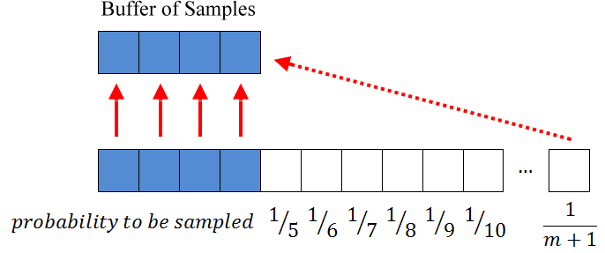
Reservoir Sampling

Slide 46
Decision tree for the reservoir sampling algorithm of stream a1,a2,a3,a4.
The algorithm randomly decides to take or not to take (“yes” or “no”) the considered input item as the actual sample s.
Each node is labeled by the probability of the previous decision and its color indicates the item currently chosen as s.
The probability of a specific path through this tree results from multiplying the probabilities along this path.

Slide 47
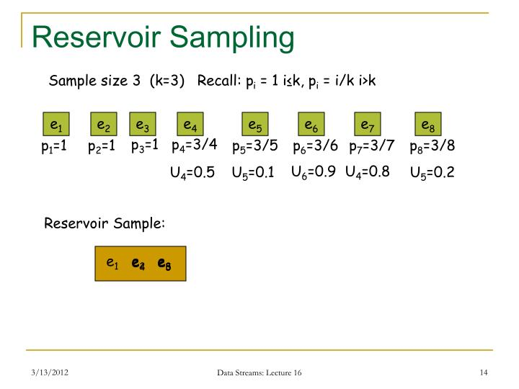

Slide 48
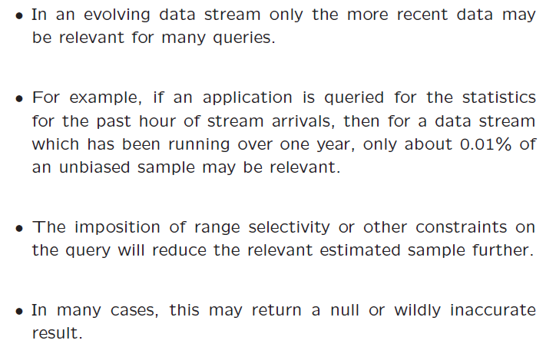
Reservoir Sampling - Issues

Slide 49
Reservoir Sampling - Issues

Slide 50
Possible Solutions

Slide 51
Biased Reservoir Sampling

Slide 52
Biased Reservoir Sampling
A bias function to regulate the sampling from the stream.
This bias gives a higher probability of selecting data points from recent parts of the stream as compared to distant past.
This bias function is quite effective since it regulates the sampling in a smooth way so that queries over recent horizons are more accurately resolved.

Slide 53
Concise Sampling
Note that the size of the reservoir is sometimes restricted by the available main memory.
The method of concise sampling exploits the fact that the number of distinct values of an attribute is often signiﬁcantly smaller than the size of the data stream.
The sample is maintained as a set S of <value, count> pairs.
For those pairs in which the value of count is one, we do not maintain the count explicitly, but we maintain the value as a singleton.
The number of elements in this representation is referred to as the footprint

Slide 54
Concise Sampling
Duplicates in sample S stored as <value, count> pairs (thus, potentially boosting actual sample size)
Add each new element to S with probability 1/T (simply increment count if element already in S)
If sample size exceeds M
Select new threshold T’ > T
Evict each element (decrement count) from S with probability 1-T/T’
Add subsequent elements to S with probability 1/T’

Slide 55
Concise-Sampling Example
Dataset
D = { a, a, a, b, b, b }
Footprint
F = one <value, #> pair
Three (possible) samples of size = 3
S₁ = { a, a, a }, S₂ = { b, b, b }, S₃ = { a, a, b }.
S₁ = {<a,3>}, S₂ = {<b,3>}, S₃ = {<a,2>,<b,1>}.
Three samples should have with equal likelihood
But Prob(S₁) = Prob(S₂) > 0 and Prob(S₃) = 0
In general:
Concise sampling under-represents ‘rare’ population elements

Slide 56
Detailed Algorithm
threshold parameter τ - probability of successive sampling from the stream; As the points arrive, we add to sample with 1/ τ if the corresponding value count pair is already included in the set S, the footprint size does not increase.
if not or exists as a singleton then the foot print increases by 1.
May potentially require the removal of an element from sample S
Pick a new (higher) value of the threshold τ′, and apply this threshold to the footprint in repeated passes.
In each pass, we reduce the count of a value with probability (τ/ τ′), until at least one value-count pair reverts to a singleton or a singleton is removed.
Subsequent points from the stream are sampled with probability (1/ τ′)

Slide 59
Filtering data

Slide 60
Review: Bloom Filters
Given a set S = {x₁,x₂,x₃,…x_{n}} on a universe U, want to answer queries of the form:
Bloom filter provides an answer in
“Constant” time (time to hash).
Small amount of space.
But with some probability of being wrong.

Slide 61
Bloom Filter
A space-efficient probabilistic data structure, conceived by Burton Howard Bloom, used to test membership
False positive possible, but no false negatives (100% recall rate).
Query returns "possibly in set" or "definitely not in set".
Elements can be added to the set, but not removed
More elements that are added to the set, the larger the probability of false positives
Uses considerably less space than any exact method, but pays for this by introducing a small probability of error

Slide 62
First Example Scenario
Suppose you are creating an account on Goodreads, you want to enter a cool username, you entered it and got a message, “Username is already taken”.
You added your birth date along username, still no luck. Now you have added your university roll number also, still got “Username is already taken”. It’s really frustrating, isn’t it?
But have you ever thought how quickly Goodreads checks the availability of username by searching millions of username registered with it.
Linear search : Bad idea!
Binary Search : Way too much work Sorting etc !!

Slide 63
Scenario Contd.
Bloom Filter is a data structure that can do this job.
What is Bloom Filter?
A Bloom filter is a space-efficient probabilistic data structure that is used to test whether an element is a member of a set.
For example, checking availability of username is set membership problem, where the set is the list of all registered username.
The price we pay for efficiency is that it is probabilistic in nature that means, there might be some False Positive results.
False positive means, it might tell that given username is already taken but actually it’s not.

Slide 64
Example - Google Chrome
Chrome needs to store a blacklist of dangerous URLs.
Each time a user is about to navigate to new page, need to check against the blacklist
Size of black list – around a million; Min and max length of a URL is 2 -2083.
Thus, we may need disk accesses to determine whether the current URL is to be allowed or not.
Considering the large numbers of users accessing websites using Chrome continuously, this is indeed a data steam with very high velocity
Algorithm will use main mem only and yet will filter most of the undesired stream elements.

Slide 65
Motivating Example
Let us assume we want to use about one megabyte of available main memory to store the blacklist.
Bloom filter uses the main memory as a bit array being able to store eight million bits.
A hash function “h” that maps each URL in the blacklist to one of eight million buckets. That corresponding bit in the bit array is set to 1. All other bits of the array remain 0.
It is possible that two URLs could hash to the same bit.
When a stream element arrives, we hash its URL. If the bit to which it hashes is 1, then we need to further check whether this URL is safe for browsing or not.
But if the URL hashes to a 0, then definitely address is not in the blacklist so we can ignore this stream element.

Slide 66
Simple Example

Slide 67
Bloom Filters
Bloom filters compactly encode set membership
k hash functions map items to bit vector k times
Set all k entries to 1 to indicate item is present
Can lookup items, store set of size n in ~ 2n bit
item
1
1
1

Slide 68
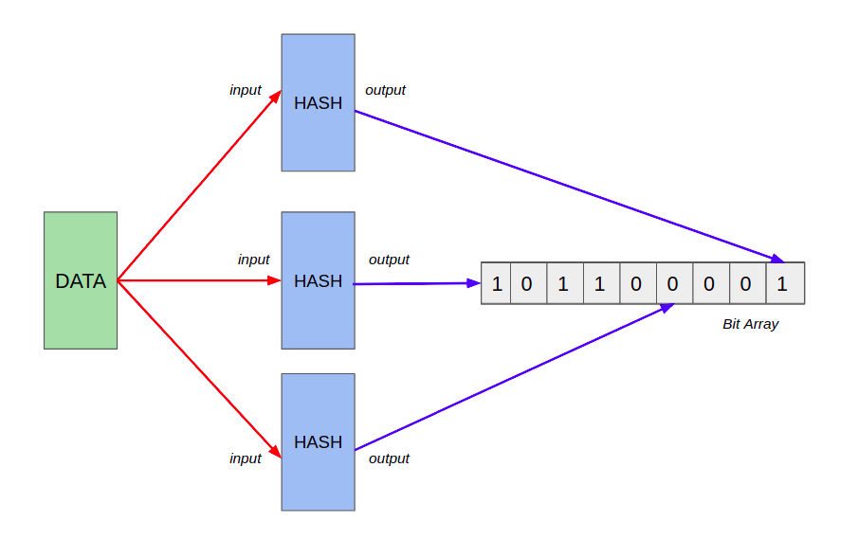
3 Hash Function Bloom Filter

Slide 69
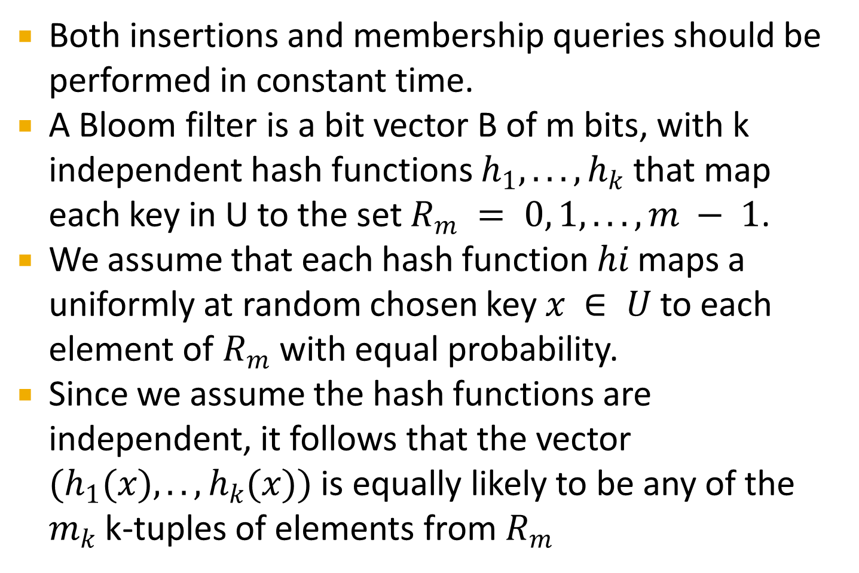
Bloom Filter Overview
Both insertions and membership queries should be performed in constant time.
A Bloom filter is a bit vector B of m bits, with k independent hash functions $h_{1}, ..., h_{k}$ that map each key in U to the set $R_{m} = 0, 1, ..., m − 1$.
We assume that each hash function $hi$maps a uniformly at random chosen key $x ∈ U$ to each element of $R_{m}$ with equal probability.
Since we assume the hash functions are independent, it follows that the vector $(h_{1}(x), .., h_{k}(x))$ is equally likely to be any of the $m_{k}$ k-tuples of elements from $R_{m}$

Slide 70
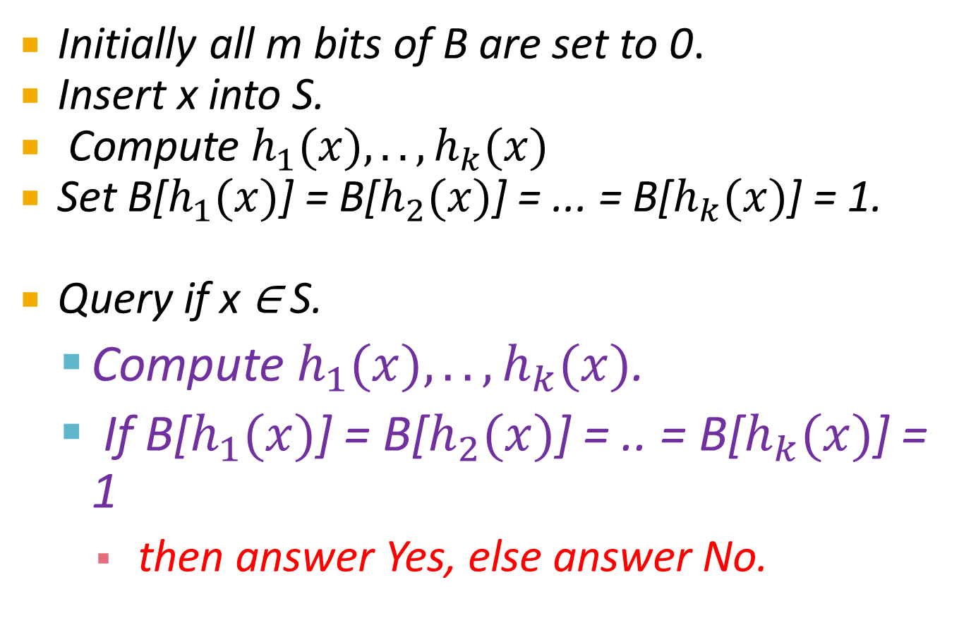
Algorithm
Initially all m bits of B are set to 0.
Insert x into S.
Compute $h_{1}(x), .., h_{k}(x)$
Set B[$h_{1}(x)$] = B[$h_{2}(x)$] = ... = B[$h_{k}(x)$] = 1.
Query if x ∈ S.
Compute $h_{1}(x), .., h_{k}(x)$.
If B[$h_{1}(x)$] = B[$h_{2}(x)$] = .. = B[$h_{k}(x)$] = 1
then answer Yes, else answer No.

Slide 71
Bloom Filters
Start with an m bit array, filled with 0s.
B
0
0
0
0
0
0
0
0
0
0
0
0
0
0
0
0
Hash each item x_{j} in S k times. If H_{i}(x_{j}) = a, set B[a] = 1.
B
0
1
0
0
1
0
1
0
0
1
1
1
0
1
1
0
To check if y is in S, check B at H_{i}(y). All k values must be 1.
B
0
1
0
0
1
0
1
0
0
1
1
1
0
1
1
0
Possible to have a false positive; all k values are 1, but y is not in S.
B
0
1
0
0
1
0
1
0
0
1
1
1
0
1
1
0
n items m = cn bits k hash functions

Slide 72
Errors
Assumption: We have good hash functions, look random.
Given m bits for filter and n elements, choose number k of hash functions to minimize false positives:
Let
Let
As k increases, more chances to find a 0, but more 1’s in the array.
Find optimal at k = (ln 2)m/n by calculus.

Slide 73
The probability of a false positive
We assume the hash function are random.
After all the elements of S are hashed into the bloom filters ,the probability that a specific bit is still 0 is

Slide 74
Analysis
The probability of a false positive f is
To find the optimal k to minimize f .
Minimize f iff minimize g=ln(f)
k=ln(2)*(n/m)
f = (1/2)^{k} = (0.6185..)^{n/m}
The false positive probability falls exponentially in n/m ,the number bits used per item !!

Slide 75
Example
10000 possible keys, in a Bloom filter of exactly N =100 cells, and that we care only about the accuracy of the Bloom filter and not its speed.
For this problem size, what is the best choice of the number of cells per key? (I.e., what value of k gives the smallest possible probability that a key not in S is a false positive?)
What is the probability of a false positive for this choice of k?

Slide 76
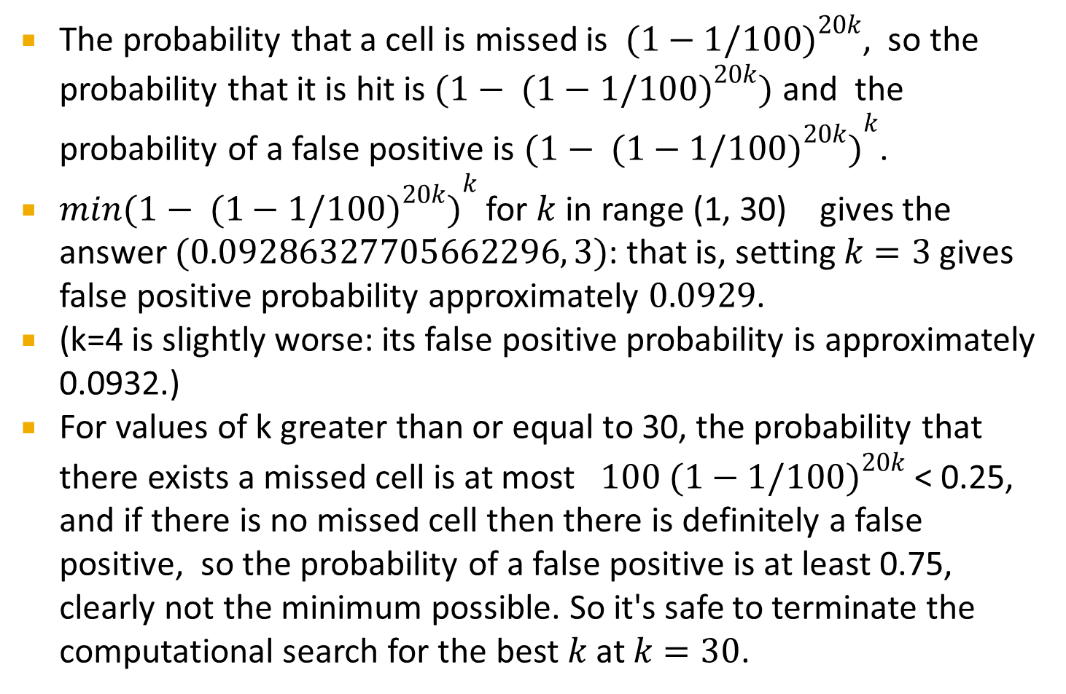
Solution
The probability that a cell is missed is ${ (1−1/100)}^{20k}$, so the probability that it is hit is $(1 − { (1−1/100)}^{20k})$ and the probability of a false positive is ${(1 − { (1−1/100)}^{20k})}^{k}$.
$min{(1 − { (1−1/100)}^{20k})}^{k}$ for $k$ in range (1, 30) gives the answer $(0.09286327705662296, 3)$: that is, setting $k=3$ gives false positive probability approximately $0.0929$.
(k=4 is slightly worse: its false positive probability is approximately 0.0932.)
For values of k greater than or equal to 30, the probability that there exists a missed cell is at most ${ 100 (1−1/100)}^{20k}$ < 0.25, and if there is no missed cell then there is definitely a false positive, so the probability of a false positive is at least 0.75, clearly not the minimum possible. So it's safe to terminate the computational search for the best $k$ at $k=30$.

Slide 77
Tradeoffs
Three parameters.
Size m/n : bits per item.
Time k : number of hash functions.
Error f : false positive probability.

Slide 78
Overview
At the heart of every bloom filter lies two key elements
An array of n bits, initially all set to 0.
A collection of k independent hash functions h(x). Each hash function takes a value v and generates a number i where i < n which effectively maps to a position in the bit array.
The underlying idea of a bloom filter is quite simple
Initialize bit array of n bits with 0s. n >> no. of elements in the set.
Whenever the filter sees a new element apply each of the hash functions h(x) on the element. With the value generated, which is an index in the bit array, set the bit to 1 in the array.
If there are k hash functions there will be k indices generated. For each of these k positions in the bit array set array[i] = 1
To check if element is in the set, the same procedure with a twist.
Generate k values by applying the k hash-functions on the input. If at least one of these k indices in the bit array is set to zero then the element is a new element else this is an existing element in the set.

Slide 79
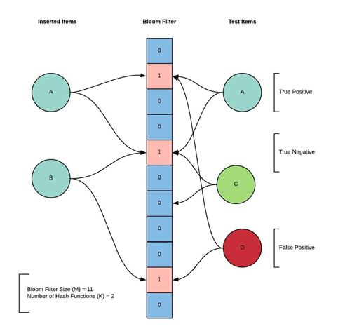

Slide 80
Interesting Properties of Bloom Filters
Unlike a standard hash table, a Bloom filter of a fixed size can represent a set with an arbitrarily large number of elements.
Adding an element never fails. However, the false positive rate increases steadily as elements are added until all bits in the filter are set to 1, at which point all queries yield a positive result.
Bloom filters never generate false negative result, i.e., telling you that a username doesn’t exist when it actually exists.
Deleting elements from filter is not possible because, if we delete a single element by clearing bits at indices generated by k hash functions, it might cause deletion of few other elements.

Slide 81
Some More Examples
The servers of Akamai Technologies, a content delivery provider, use Bloom filters to prevent "one-hit-wonders" from being stored in its disk caches.
One-hit-wonders are web objects requested by users just once, something that Akamai found applied to nearly three-quarters of their caching infrastructure.
Using a Bloom filter to detect the second request for a web object and caching that object only on its second request prevents one-hit wonders from entering the disk cache, significantly reducing disk workload and increasing disk cache hit rates.
Google Bigtable, Apache HBase and Apache Cassandra, and Postgresql use Bloom filters to reduce the disk lookups for non-existent rows or columns. Avoiding costly disk lookups considerably increases the performance of a database query operation

Slide 82
Some Examples
The Squid Web Proxy Cache uses Bloom filters for cache digests.
Bitcoin uses Bloom filters to speed up wallet synchronization.
The Venti archival storage system uses Bloom filters to detect previously stored data.
The SPIN model checker uses Bloom filters to track the reachable state space for large verification problems.
The Cascading analytics framework uses Bloom filters to speed up asymmetric joins, where one of the joined data sets is significantly larger than the other (often called Bloom join in the database literature).
Prime Video uses Bloom filters effectively to avoid duplicate recommendations
Medium uses Bloom filters to avoid recommending articles a user has previously read.
Ethereum uses Bloom filters for quickly finding logs on the Ethereum blockchain

Slide 83
Examples
Joins on distributed relations
Spell Check
Weak Password Dictionary - Store dictionary of easily guessable passwords as bloom filter, query when users pick passwords.
Virus Signature detection
Inventory checks
Any Unique Identification System has to generate a unique number for newly registered users. If the number of user registrations increase dramatically, checking with the database is too expensive. In this case, a bloom filter can tell if a number has already been generated or not. If yes, simply generate a new random number and check with the filter again. Keep doing this till the bloom filter returns false.

Slide 84
Popular hash algorithms
DJB2
DJB2a (variant using xor rather than +)
FNV-1 (32-bit)
FNV-1a (32-bit)
SDBM
CRC32
Murmur2 (32-bit)
SuperFastHash

Slide 85
Example
In this section, we present an example using Bloom filters. We assume having an array of 10 bits that are all set to 0. Also, we assume using two simple hash functions:
1) h 1(x) = x mod 10
2)h 2(x)=(5x+4)mod10
Initially, we have the following (empty) bloom filter:
0 1 2 3 4 5 6 7 8 9
0 0 0 0 0 0 0 0 0 0

Slide 86
Insertion
To insert 19 in bloom filter, we compute the digests of h1, h2 :
h1(19) = 19 mod 10 = 9
h2(19)= (5*19+4)mod 10 = 99mod 10 = 9
Then, the bit in 9th position of the filter is set to 1. After insertion of 19 the filter is :

Slide 87
Insert
Similarly, to insert 132 we compute
H1 (132) = 2
H2 (132) = 4.
Then the bits in positions 2 and 4 are set to 1. The filter now is :

Slide 88
Insert
Finally, regarding insertion of 25, digests of hash functions are
h1(25) = 5
h2(25) = 9
Bit 5 is set 1. Bit 9 is already 1, as it has been set by the insertion of element 19. Bloom filter after the insertion of 25 is :

Slide 89
Existence Checks
Now, we check using the previously formed Bloom filter for the existence of the elements 133, 25 and 24 in the set A.
To check if element 133 exists in A, we first compute the digests of h1, h2: h1(133) = 3 h2(133) = 9
Then we check whether the bits of positions 3 and 9 of the Bloom filter are set to 1. Although bit 9 is set, the bit in position 3 is 0. As a result, the filter returns NO.
To check if element 25 exists in A, we compute h1(25) = 5 and h2(25) = 9. Then we check whether the bits of positions 5 and 9 of the Bloom filter are set to 1. Indeed, both bits are 1. So, Bloom filter returns YES. It is a true positive, as 25 exists in the set.
To check if element 24 exists in A, we compute h1(24) = 24 mod 10 = 4 & h 2(24) = 124 mod 10 = 4 . Then we check whether the bits of position 4 is set to 1. Indeed, it is set to 1. Although Bloom filter return again YES, element 24 does not exist in the set (resulting in a false positive).

Slide 90
Example

Slide 91
Using the Bloom Filter

Slide 92
Sketches
Not every problem can be solved with sampling
Example: counting how many distinct items in the stream
If a large fraction of items aren’t sampled, don’t know if they are all same or all different
Other techniques take advantage that the algorithm can “see” all the data even if it can’t “remember” it all
“Sketch”: essentially, a linear transform of the input
Model stream as defining a vector, sketch is result of multiplying stream vector by an (implicit) matrix
linear projection

Slide 93

Counting Distinct Elements in a Stream

Slide 94
Problem Description
Given a data stream of n insertions of records, count the number F₀ of distinct records
One pass over the data stream
Algorithms must use small amount of memory and have fast update time
too expensive to store set of distinct records
implies algorithms must be randomized and must settle for an approximate solution: output
F Є [(1-ἐ)F₀, (1+ ἐ)F₀] with constant probability

Slide 95
Some Applications
How many different words are found among the Web pages being crawled at a site?
Unusually low or high numbers could indicate artificial pages (spam?).
How many different Web pages does each customer request in a week?

Slide 96
Simple Solution
Keep an array, a[0, ..,U], initially set to 0.
Also keep a counter C initialized to 0.
Every time an item i arrives, look at a[i].
If it is zero, increment C, and set a[i] = 1
Return C as the number of distinct items
Time: O(1) per update and per query
But space is O(U).
What happens if we do not have enough memory to store all the distinct items?–The Flajolet-Martin Sketch.

Slide 97
Using Small Storage
Real Problem: what if we do not have space to store the complete set?
Estimate the count in an unbiased way.
Accept that the count may be in error, but limit the probability that the error is large.

Slide 98
Challenge
Example (N=64)
Data stream: 3 2 5 3 2 1 7 5 1 2 3 7
Number of distinct values: 5
Hard problem for random sampling!
Must sample almost the entire table to guarantee the estimate is within a factor of 10 with probability > 1/2, regardless of the estimator used!

Slide 99
Vector Interpretation
Stream: 8 2 1 9 1 9 2 4 4 9 4 2 5 4 2 5 8 5 2 5
Vector X:
1 2 3 4 5 6 7 8 9
Initially, x=0
Insertion of i is interpreted as
x_{i} = x_{i} +1
Want to estimate DE(x) = the number of non-zero elements of x

Slide 100
The Flajolet-Martin algorithm
The Flajolet-Martin algorithm uses the position of the rightmost set and unset bit to approximate the count-distinct in a given stream.
The two seemingly unrelated concepts are intertwined using probability.
It uses extra storage of order O(log m) where m is the number of unique elements in the stream and provides a practical estimate of the cardinalities.

Slide 101
Basic Idea of FM
The basic idea.
Keep an array a[1.... log U]
Use a hash function f : {1...U} → {0.... log U}
Compute f (i) for every item in the stream, and set a[f (i)] = 1.
Somehow extract from this the approximate number of distinct items.
Space requirement=O(log U) = O(log N), assuming hash functions do not require too much of space.

Slide 102
Flajolet-Martin Approach - Intuition
Suppose we had a good, random hash function that acted on strings and generated integers, what can we say about the generated integers? Since they are random themselves, we would expect:
1/2 of them to have their binary representation end in 0 (i.e. divisible by 2 ),
1/4 of them to have their binary representation end in 00 (i.e. divisible by 4 )
1/8 of them to have their binary representation end in 000 (i.e. divisible by 8 )
and in general, 1/2^n of them to have their binary representation end in 0^n .
Turning the problem around, if the hash function generated an integer ending in 0^m bits (and it also generated integers ending in 0^{m-1} bits, 0^{m-2} bits, ..., 0^1 bits), intuitively, the number of unique strings is around 2^m .

Slide 103
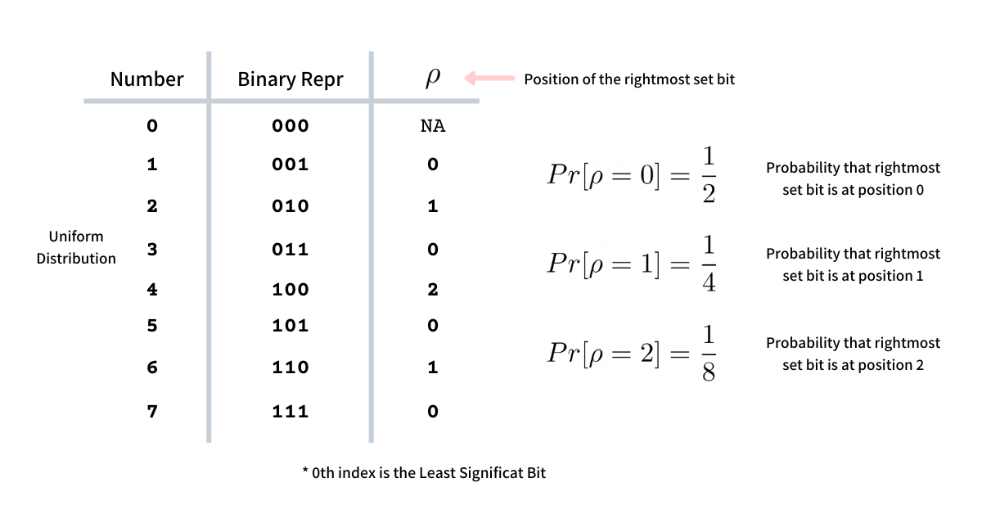

Intuition
In general, we can say, the probability of the rightmost set bit, in binary presentation, to be at the position k in a uniform distribution of numbers is

Slide 104
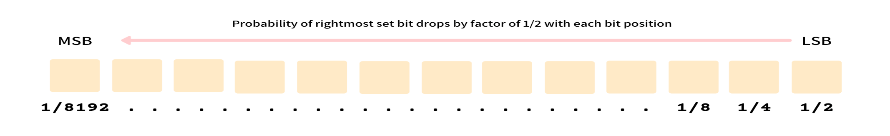
Intuition
The probability of the rightmost set bit drops by a factor of 1/2 with every position from the LSB to MSB
So if we keep on recording the position of the rightmost set bit, ρ, for every element in the stream (assuming uniform distribution) we should expect ρ = 0 to be 0.5, ρ = 1 to be 0.25, and so on. This probability should become 0 when bit position, b is b > log m while it should be non-zero when b <= log m where m is the number of distinct elements in the stream.
Hence, if we find the rightmost unset bit position b such that the probability is 0, we can say that the number of unique elements will approximately be 2 ^ b. This forms the core intuition behind the Flajolet Martin algorithm.

Slide 105
Flajolet-Martin Approach
Pick a hash function h that maps each of the n elements to at least log₂n bits.
For each stream element a, let r (a ) be the number of trailing 0’s in h (a ).
Record R = the maximum r (a ) seen.
Estimate = 2^{R}.

Slide 106
Simplified
Create a bit vector (bit array) of sufficient length L , such that 2^{L}>n , the number of elements in the stream. Usually a 64-bit vector is sufficient since 2^{{64}} is quite large for most purposes.
The i-^{th} bit in this vector/array represents whether we have seen a hash function value whose binary representation ends in 0^{i} . So initialize each bit to 0.
Generate a good, random hash function that maps input (usually strings) to natural numbers.
Read input. For each word, hash it and determine the number of trailing zeros. If the number of trailing zeros is k, set the k-th bit in the bit vector to 1.

Slide 107
Simplified
Once input is exhausted, get the index of the first 0 in the bit array (call this R). By the way, this is just the number of consecutive 1s (i.e. we have seen 0, 00, ..., as the output of the hash function) plus one.
Calculate the number of unique words as
2^R * Constant .

Slide 108
Simple Explanation
We start with defining a closed hash range, big enough to hold the maximum number of unique values possible - something as big as 2 ^ 64.
Every element of the stream is passed through a hash function that permutes the elements in a uniform distribution.
For this hash value, we find the position of the rightmost set bit and mark the corresponding position in the bit vector as 1, suggesting that we have seen the position.
Once all the elements are processed, the bit vector will have 1s at all the positions corresponding to the position of every rightmost set bit for all elements in the stream.
Now we find the position, b, of the rightmost 0 in this bit vector. This position b corresponds to the rightmost set bit that we have not seen while processing the elements.
This corresponds to the probability 0 and hence as per the intuition will help in approximating the cardinality as 2 ^ b.

Slide 109
FM Algorithm
Use r hash functions to create r FM Sketches
Initialize each FM to zero
For each record x in dataset
For each hash function h_{i}(x)
FM_{i}[pivot] = 1;
Let B_{i} be the position of left most 0-bit of FM_{i}
B = (B₁ + B₂ … + B_{r} )/ r
Number of distinct elements = α * 2^{B}
where α = 1.2897385
FM₁
1 | 0 | 1 | 0
B₁ = 1
FM₂
1 | 1 | 0 | 0
B₂ = 2
FM₃
1 | 1 | 0 | 1
B₃ = 2
B = (1 + 2 + 2)/3 = 1.67

Slide 110
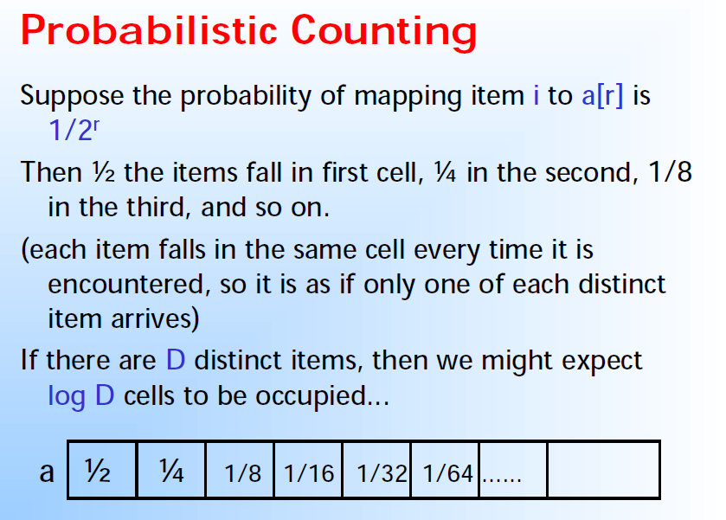

Slide 111
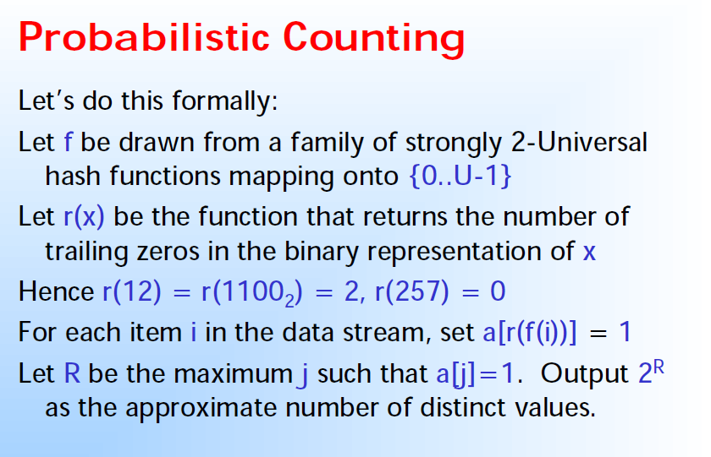

Slide 112
Examples
int X | binary format | R(x)
0 | 0000 | 4 (=L)
1 | 0001 | 0
2 | 0010 | 1
3 | 0011 | 0
4 | 0100 | 2
5 | 0101 | 0
6 | 0110 | 1
7 | 0111 | 0
8 | 1000 | 3
X=10=(1010)2
bit(y,0)=0 bit(y,1)=1 bit(y,2)=0 bit(y,3)=1

Slide 113
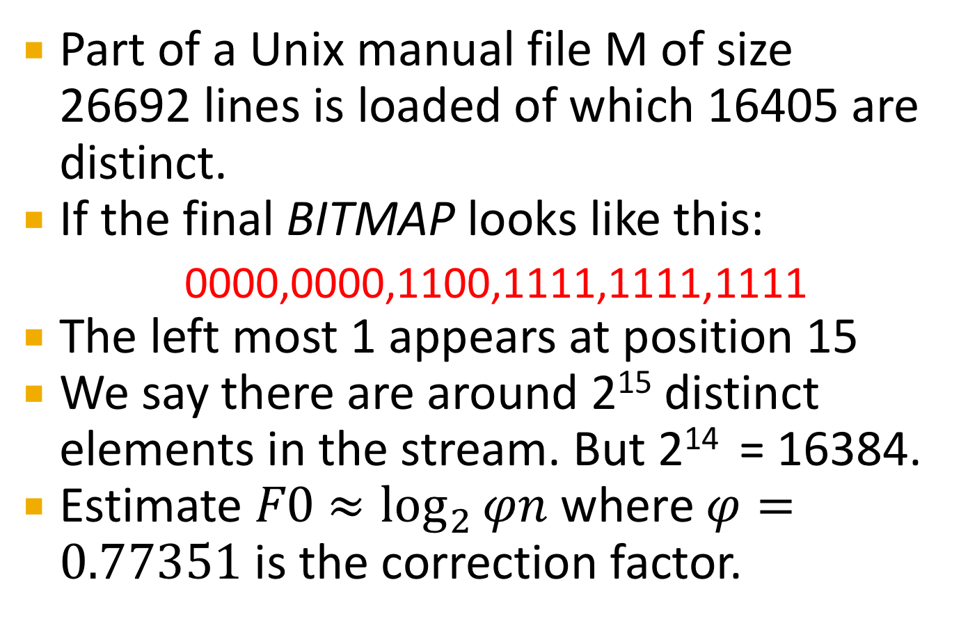
Flajolet-Martin Approach – Estimate Example
Part of a Unix manual file M of size 26692 lines is loaded of which 16405 are distinct.
If the final BITMAP looks like this:
0000,0000,1100,1111,1111,1111
The left most 1 appears at position 15
We say there are around 2¹⁵ distinct elements in the stream. But 2¹⁴ = 16384.
Estimate $F0$ $≈\log_{2}{φn}$ where$φ=0.77351$ is the correction factor.

Slide 114
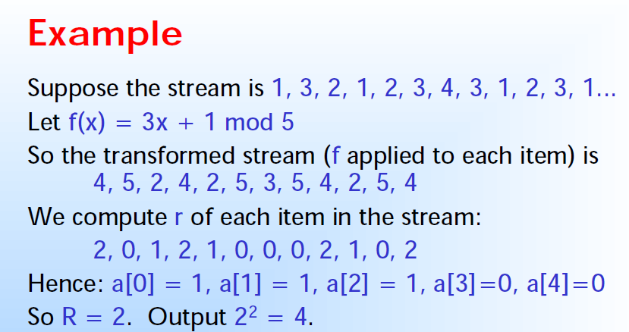

Slide 115
Example

Slide 116
Why It Works
The probability that a given h (a ) ends in at least r 0’s is 2^{-r}.
If there are m different elements, the probability that R ≥ r is 1 – (1 - 2^{-r} )^{m}.
Since 2^{-r} is small, 1 - (1-2^{-r})^{m} ≈ 1 - e ^{-m2} .
Thus, 2^{R} will almost always be around m.
Prob. all h(a)’s
end in fewer than
r 0’s.
Prob. a given h(a)
ends in fewer than
r 0’s.

Slide 117
Why It Doesn’t Work
E(2^{R} ) is actually infinite.
Probability halves when R -> R +1, but value doubles.
Workaround involves using many hash functions and getting many samples.
How are samples combined?
Average? What if one very large value?
Median? All values are a power of 2.

Slide 118
Variations of F-M Algorithm
Take the mean of the k results together from each hash-function, obtaining a single estimate of the cardinality.
A different idea is to use the median which is less prone to be influences by outliers.
Another problem with this is that the results can only take form as some power of 2
A common solution is to combine both the mean and the median:
Create k⋅ℓ hash-functions and split them into k distinct groups (each of size ℓ).
Within each group use the median for aggregating together the ℓ results
Finally take the mean of the k group estimates as the final estimate.

Slide 119
Space Requirement
As we read the stream it is not necessary to store the elements seen.
The only thing we need to keep in main memory is one integer per hash function; this integer records the largest tail length seen so far for that hash function and any stream element.
If we are processing only one stream, we could use millions of hash functions, which is far more than we need to get a close estimate.
Only if we are trying to process many streams at the same time would main memory constrain the number of hash functions we could associate with any one stream.
In practice, the time it takes to compute hash values for each stream element would be the more significant limitation on the number of hash functions we use.

Slide 120
Example
x | h(x) | Rem | Binary | r(a)
1 | 7 | 2 | 00010 | 1
3 | 19 | 4 | 00100 | 2
2 | 13 | 3 | 00011 | 0
1 | 7 | 2 | 00010 | 1
2 | 13 | 3 | 00011 | 0
3 | 19 | 4 | 00100 | 2
4 | 25 | 0 | 00000 | 5
3 | 19 | 4 | 00100 | 2
1 | 7 | 2 | 00010 | 1
2 | 13 | 3 | 00011 | 0
3 | 19 | 4 | 00100 | 2
1 | 7 | 2 | 00010 | 1
S=1,3,2,1,2,3,4,3,1,2,3,1
h(x)=(6x+1) mod 5
Assume |b| = 5
R = max( r(a) ) = 5
So no. of distinct elements = N=2^{R}=2⁵=32

Slide 121
Applications
Web sites often gather statistics on how many unique users it has seen in each given month. The universal set is the set of logins for that site, and a stream element is generated each time a user logs in.
Amazon: user logs in with their unique login name.
Google: identifies users by IP addresses.
Radio-frequency identification (RFID) technology uses RFID tags and RFID readers (or simply called tags and readers) to monitor objects in physical world.
Many events (e.g., TedEx) distribute RFID wrist bands to their visitors. RFID counting helps reveal the number of people around.

Slide 122
Applications
DNA Motifs: Sequence motifs are short, recurring patterns in DNA that are presumed to have a biological function.
Number of distinct motifs indicate valuable biological information about the specific DNA sequence.
Denial of service attacks signaled by large numbers of requests from spoofed IPs.
Counting distinct elements provide valuable statistics in these cases.

Slide 123
Duplicate Insensitive Counting
Distinct-values estimation can also be used as a general tool for Each item to be counted views its unique id as its “value”, so that the number of distinct values equals the number of items to be counted.
Duplicate-insensitive counting is useful in mobile computing to avoid double counting nodes that are in motion.
It can also be used to compute the number of distinct neighborhoods at a given hop-count from a node and the size of the transitive closure of a graph.
In a sensor network, duplicate insensitive counting together with multi-path in-network aggregation enables robust and energy-efficient answers to count queries
Moreover, duplicate insensitive counting is a building block for duplicate-insensitive computation of other aggregates, such as sum and average.

Slide 124
Some Results
Wikipedia article on "United States Constitution" had 3978 unique words. When run ten times, Flajolet-Martin algorithm reported values of 4902, 4202, 4202, 4044, 4367, 3602, 4367, 4202, 4202 and 3891 for an average of 4198. As can be seen, the average is about right, but the deviation is between -400 to 1000.
The algorithm was run on the text dump of The Jungle Book by Rudyard Kipling. The text was converted into a stream of tokens and it was found that the total number of unique tokens was 7150. The approximation of the same using the Flajolet-Martin algorithm came out to be 7606 which in fact is pretty close to the actual number.

Slide 125
Extra Examples
Stream: 4, 2, 5 ,9, 1, 6, 3, 7 Hash function, h(x) = (ax + b) mod 32 a) h(x) = 3x + 7 mod 32 b) h(x) = x + 6 mod 32
a) h(x) = 3x + 7 mod 32 h(4) = 3(4) + 7 mod 32 = 19 mod 32 = 19 = (10011) h(2) = 3(2) + 7 mod 32 = 13 mod 32 = 13 = (01101) h(5) = 3(5) + 7 mod 32 = 22 mod 32 = 22 = (10110) h(9) = 3(9) + 7 mod 32 = 34 mod 32 = 2 = (00010) h(1) = 3(1) + 7 mod 32 = 10 mod 32 = 10 = (01010) h(6) = 3(6) + 7 mod 32 = 25 mod 32 = 25 = (11001) h(3) = 3(3) + 7 mod 32 = 16 mod 32 = 16 = (10000) h(7) = 3(7) + 7 mod 32 = 28 mod 32 = 28 = (11100) Trailing zero's {0, 0, 1, 1, 1, 0, 4, 2} R = max [Trailing Zero] = 4 ---- Output = 2^{R} = 2⁴ = 16

Slide 126
Queries over a (long) Sliding Window

Slide 127
Sliding Windows
A useful model of stream processing is that queries are about a window of length N – the N most recent elements received
Interesting case: N is so large that the data cannot be stored in memory, or even on disk
Or, there are so many streams that windows for all cannot be stored
Amazon example:
For every product X we keep 0/1 stream of whether that product was sold in the n-th transaction
We want answer queries, how many times have we sold X in the last k sales

Slide 128
Examples
Example: For each spam mail seen we emitted a 1. Now, we want to always know how many of the last million emails were spam
Example: For each tweet seen we emitted a 1 if it is positive remark. Now, we want to always know how many of the billion recent tweets were positive sentiments

Slide 129
Sliding Window: 1 Stream
Sliding window on a single stream:
N = 6
q w e r t y u i o p a s d f g h j k l z x c v b n m
q w e r t y u i o p a s d f g h j k l z x c v b n m
q w e r t y u i o p a s d f g h j k l z x c v b n m
q w e r t y u i o p a s d f g h j k l z x c v b n m
Past Future

Slide 130
Counting Bits (1)
Problem:
Given a stream of 0s and 1s
Be prepared to answer queries of the form How many 1s are in the last k bits? where k ≤ N
Obvious solution: Store the most recent N bits
When new bit comes in, discard the N+1st bit
0 1 0 0 1 1 0 1 1 1 0 1 0 1 0 1 1 0 1 1 0 1 1 0
Suppose N=6
Past Future

Slide 131
Counting Bits (2)
You can not get an exact answer without storing the entire window
Real Problem: What if we cannot afford to store N bits?
E.g., we’re processing 1 billion streams and N = 1 billion
But as usual we are happy with an approximate answer
0 1 0 0 1 1 0 1 1 1 0 1 0 1 0 1 1 0 1 1 0 1 1 0
Past Future

Slide 132
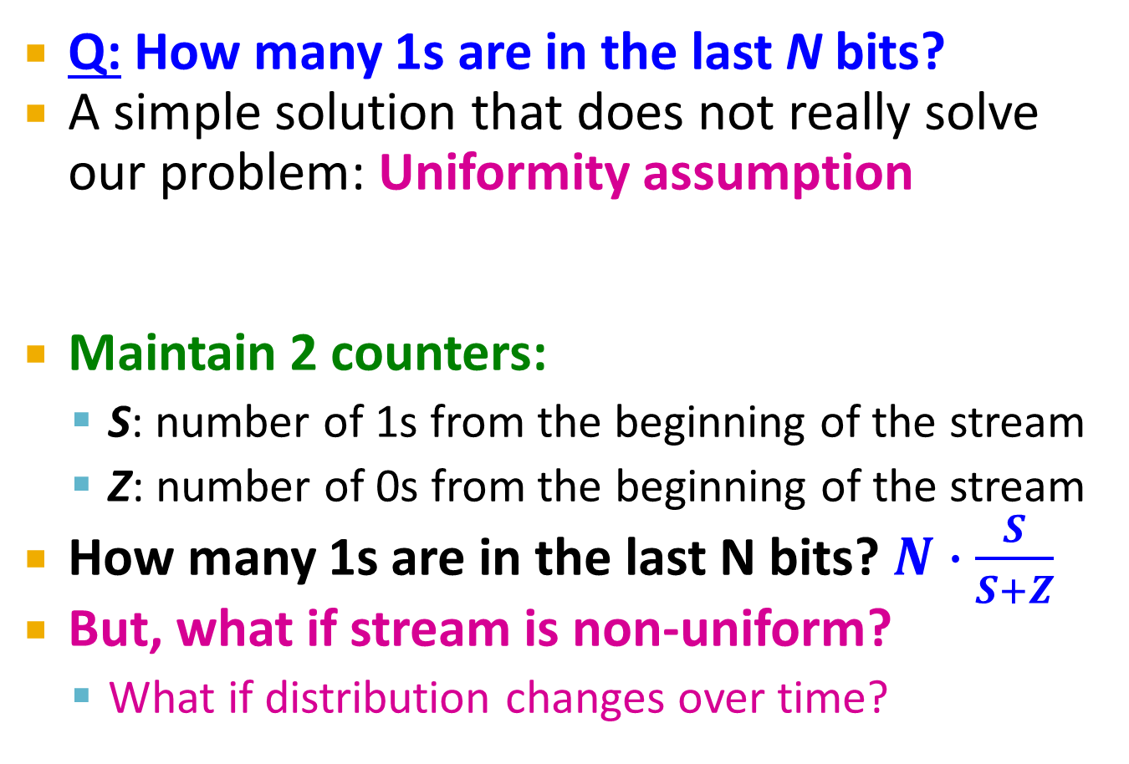
An attempt: Simple solution
Q: How many 1s are in the last N bits?
A simple solution that does not really solve our problem: Uniformity assumption
Maintain 2 counters:
S: number of 1s from the beginning of the stream
Z: number of 0s from the beginning of the stream
How many 1s are in the last N bits? $N∙\frac{S}{S+Z}$
But, what if stream is non-uniform?
What if distribution changes over time?
N
0 1 0 0 1 1 1 0 0 0 1 0 1 0 0 1 0 0 0 1 0 1 1 0 1 1 0 1 1 1 0 0 1 0 1 0 1 1 0 0 1 1 0 1 0
Past Future

Slide 133
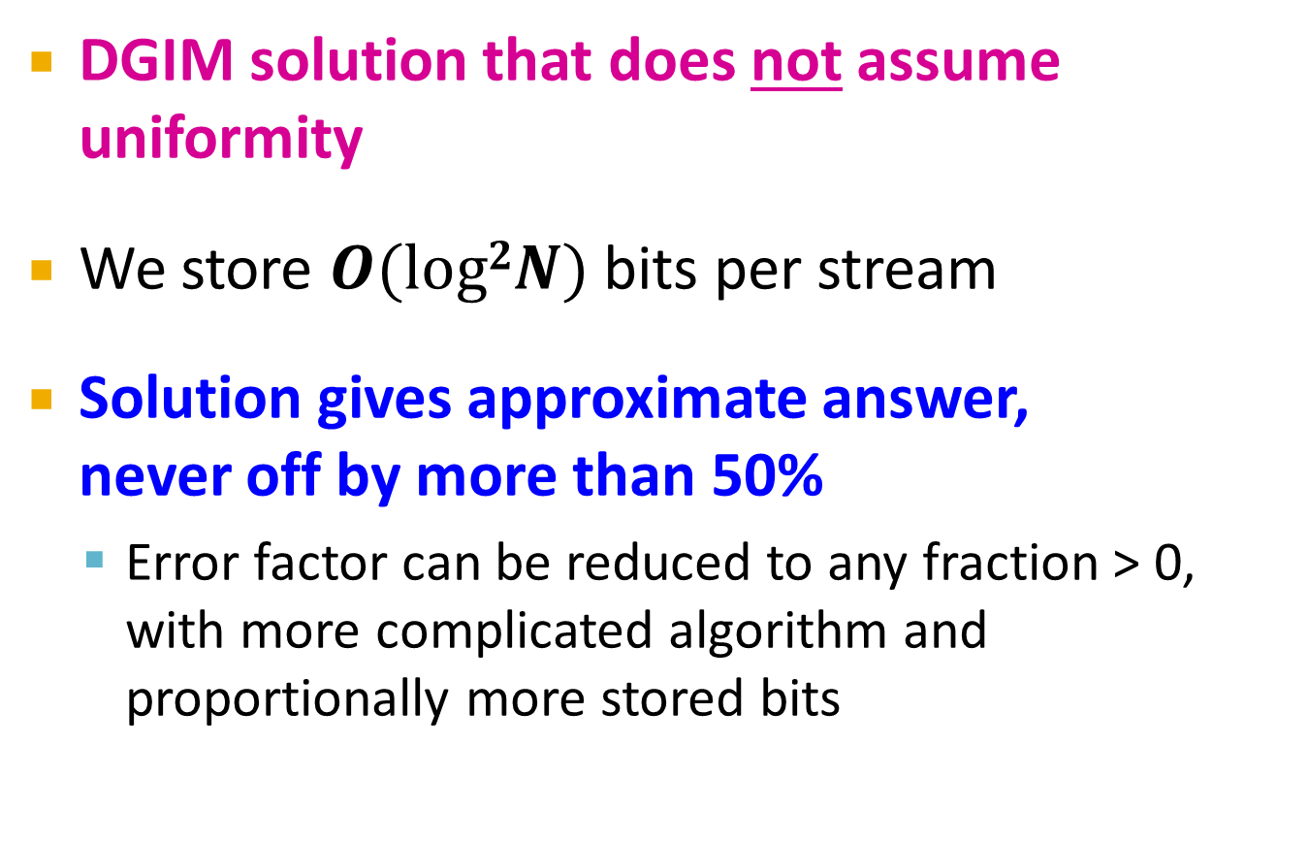
DGIM Method
DGIM solution that does not assume uniformity
We store $O(log2N)$ bits per stream
Solution gives approximate answer, never off by more than 50%
Error factor can be reduced to any fraction > 0, with more complicated algorithm and proportionally more stored bits

Slide 134
DGIM method
Idea: Instead of summarizing fixed-length blocks, summarize blocks with specific number of 1s:
Let the block sizes (number of 1s) increase exponentially
When there are few 1s in the window, block sizes stay small, so errors are small
1001010110001011010101010101011010101010101110101010111010100010110010
N

Slide 135
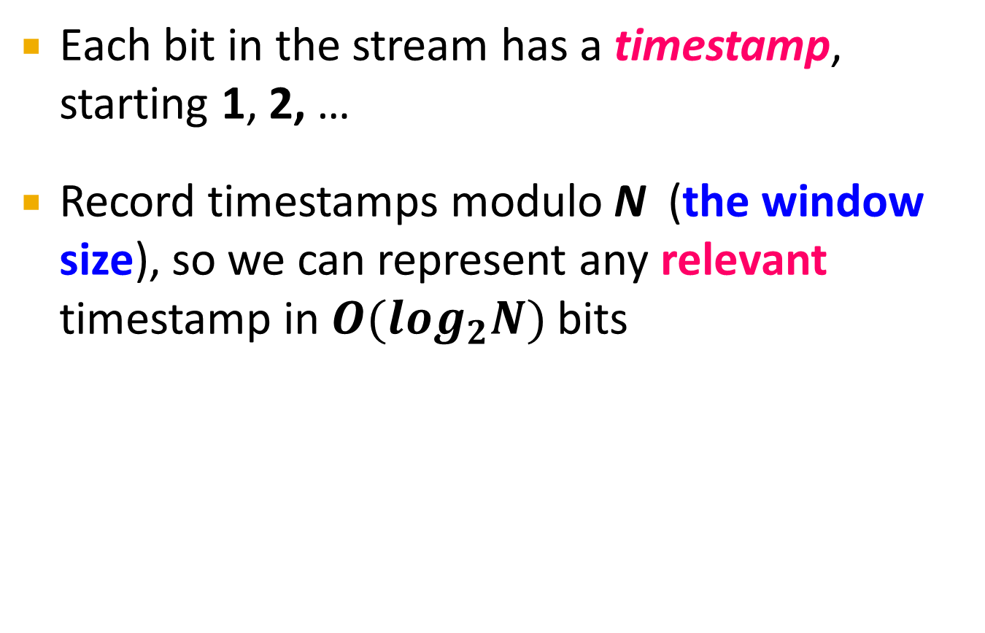
DGIM: Timestamps
Each bit in the stream has a timestamp, starting 1, 2, …
Record timestamps modulo N (the window size), so we can represent any relevant timestamp in $O(log_{2}N)$ bits

Slide 136
DGIM: Buckets
A bucket in the DGIM method is a record consisting of:
(A) The timestamp of its end [O(log N) bits]
(B) The number of 1s between its beginning and end [O(log log N) bits]
Constraint on buckets: Number of 1s must be a power of 2
That explains the O(log log N) in (B) above
1001010110001011010101010101011010101010101110101010111010100010110010
N

Slide 137
Reasoning
To represent a bucket, we need log₂ N bits to represent the timestamp (modulo N) of its right end.
To represent the number of 1’s we only need log₂ log₂ N bits.
The reason is that we know this “number i” is a power of 2, say 2^{j}, so we can represent “i” by representing (encoding) as “j” in binary.
Since j is at most log₂ N, it requires log₂ log₂ N bits.
Thus, O(logN)bits suffice to represent a bucket.

Slide 138
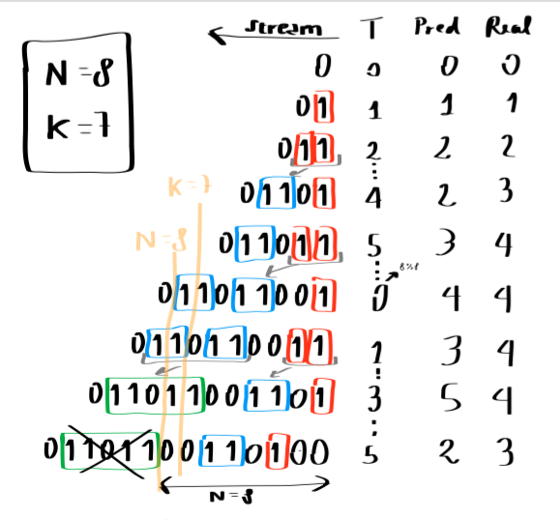
Simple Explanation

Slide 139
Representing a Stream by Buckets
Either one or two buckets with the same power-of-2 number of 1s
Buckets do not overlap in timestamps
Buckets are sorted by size
Earlier buckets are not smaller than later buckets
Buckets disappear when their end-time is > N time units in the past

Slide 140
In a nut shell

Slide 141
Example: Bucketized Stream
At least 1 of
size 16. Partially
beyond window.
2 of
size 8
2 of
size 4
1 of
size 2
2 of
size 1
1001010110001011010101010101011010101010101110101010111010100010110010
N
Three properties of buckets that are maintained:
- Either one or two buckets with the same power-of-2 number of 1s
- Buckets do not overlap in timestamps
- Buckets are sorted by size

Slide 142
Updating Buckets (1)
When a new bit comes in, drop the last (oldest) bucket if its end-time is prior to N time units before the current time
2 cases: Current bit is 0 or 1
If the current bit is 0: no other changes are needed

Slide 143
Updating Buckets (2)
If the current bit is 1:
(1) Create a new bucket of size 1, for just this bit
End timestamp = current time
(2) If there are now three buckets of size 1, combine the oldest two into a bucket of size 2
(3) If there are now three buckets of size 2, combine the oldest two into a bucket of size 4
(4) And so on …

Slide 144
Example: Updating Buckets
Current state of the stream:
1001010110001011010101010101011010101010101110101010111010100010110010
Bit of value 1 arrives
0010101100010110101010101010110101010101011101010101110101000101100101
Two orange buckets get merged into a yellow bucket
0010101100010110101010101010110101010101011101010101110101000101100101
Next bit 1 arrives, new orange bucket is created, then 0 comes, then 1:
0101100010110101010101010110101010101011101010101110101000101100101101
Buckets get merged…
0101100010110101010101010110101010101011101010101110101000101100101101
State of the buckets after merging
0101100010110101010101010110101010101011101010101110101000101100101101

Slide 145
How to Query?
To estimate the number of 1s in the most recent N bits:
Sum the sizes of all buckets but the last
(note “size” means the number of 1s in the bucket)
Add half the size of the last bucket
Remember: We do not know how many 1s of the last bucket are still within the wanted window

Slide 146
Example: Bucketized Stream
At least 1 of
size 16. Partially
beyond window.
2 of
size 8
2 of
size 4
1 of
size 2
2 of
size 1
1001010110001011010101010101011010101010101110101010111010100010110010
N

Slide 148
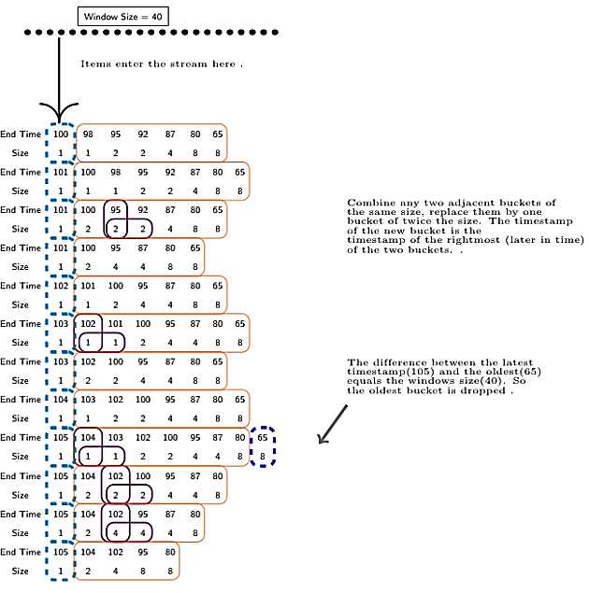

Slide 149
Counting 1’s in a Window
*
*
1
0
1
1
0
1
1
0
0
0
1
0
1
1
1
0
1
1
0
0
1
0
1
1
0
Timestamps
40
41
42
43
44
45
46
47
48
49
50
51
52
53
54
55
56
57
58
59
60
61
62
63
Bucket
(41,8)
(49,4)
(55,4)
(59,2)
(61,1)
(62,1)
Window divided into buckets represented by
Timestamp of right end
Size : Number of 1’s in a bucket (pow. of 2)
Estimating 1’s in last k=10 bits
Exact Count = 5
Estimate = Sum size of all but last and add ½ of the last bucket
= (1) + (1) + (2) + (4÷2) = 6
k = 10 bits
How many 1’s in last 10 (k) bits?

Slide 150
Error Bound: Proof
Why is error 50%? Let’s prove it!
Suppose the last bucket has size 2^{r}
Then by assuming 2^{r-1} (i.e., half) of its 1s are still within the window, we make an error of at most 2^{r-1}
Since there is at least one bucket of each of the sizes less than 2^{r}, the true sum is at least 1 + 2 + 4 + .. + 2^{r-1} = 2^{r} -1
Thus, error at most 50%
At least 16 1s
111111110000000011101010101011010101010101110101010111010100010110010
N

Slide 151
Further Reducing the Error
Instead of maintaining 1 or 2 of each size bucket, we allow either r-1 or r buckets (r > 2)
Except for the largest size buckets; we can have any number between 1 and r of those
Error is at most O(1/r)
By picking r appropriately, we can tradeoff between number of bits we store and the error

Slide 152
Extensions
Can we use the same trick to answer queries How many 1’s in the last k? where k < N?
A: Find earliest bucket B that at overlaps with k. Number of 1s is the sum of sizes of more recent buckets + ½ size of B
Can we handle the case where the stream is not bits, but integers, and we want the sum of the last k elements?
1001010110001011010101010101011010101010101110101010111010100010110010
k
Notes:
Yes, instead of bit counts keep partial sums

Slide 153
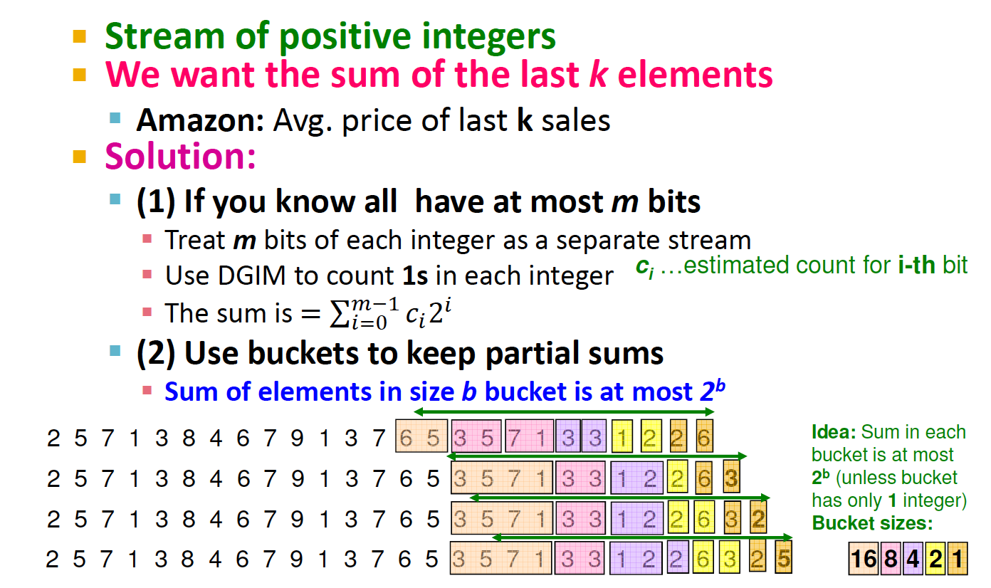
Counting positive integers

Slide 154
Summary
Stream Computation and Model
Characteristics of Stream mining Algorithms
Sampling
Filtering – Bloom Filter
Counting Distinct Elements - FM Algorithm
Counting the number of 1s in the last N elements - DGIM Algorithm

